Slide 1
Tour and Travel Agency Website
Name: Abdul Raheman.
Inter-ID: MST04-0048
Submission Date: 2/1/25

Slide 2
Introduction
This project involves the creation of a fully functional web application for a travel agency. It provides users with an intuitive platform to browse travel packages, manage bookings, and interact with dynamic content, simplifying the process of travel planning.

Slide 3
Project Overview
The Tour and Travel Agency Website provides:
- A visually engaging homepage with dynamic content.
- A booking system with real-time price calculations.
- A registration and login system for user access.
- Responsive design for multiple devices.

Slide 4
Technologies Used
- HTML, CSS, JavaScript
- Swiper.js for sliders
- JavaScript for dynamic updates and form handling
- CSS for responsive layouts.

Slide 5
System Architecture
1. Frontend: HTML, CSS, JavaScript for user interactions.
2. Dynamic Content Management: JavaScript for real-time updates.
3. Backend Simulation: Temporary in-memory storage for demo purposes.

Slide 6
Implementation Details
Key features include:
1. Dynamic UI updates for video sliders.
2. Real-time price calculations for bookings.
3. User registration and login forms.

Slide 7
Challenges Faced
1. Implementing dynamic content updates.
2. Ensuring responsive design for various devices.
3. Validating user input effectively.

Slide 8
Future Enhancements
- Backend database integration for persistent storage.
- Advanced filtering and search for packages.
- Payment gateway integration.
- User dashboards for managing bookings.

Slide 9
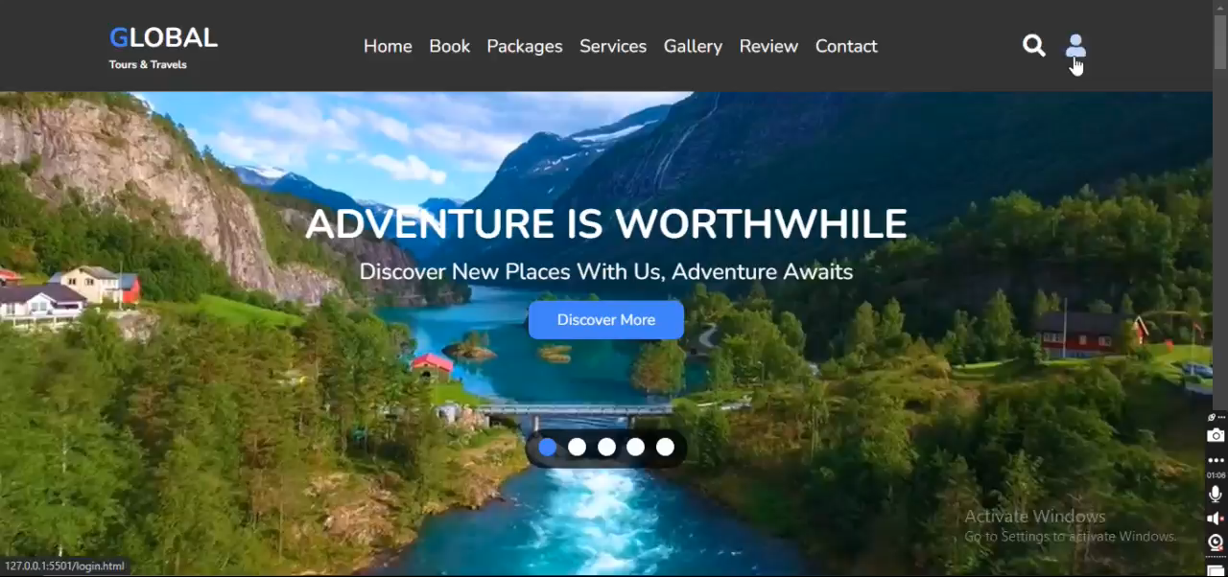
Code Screenshot: User Registration

Slide 10
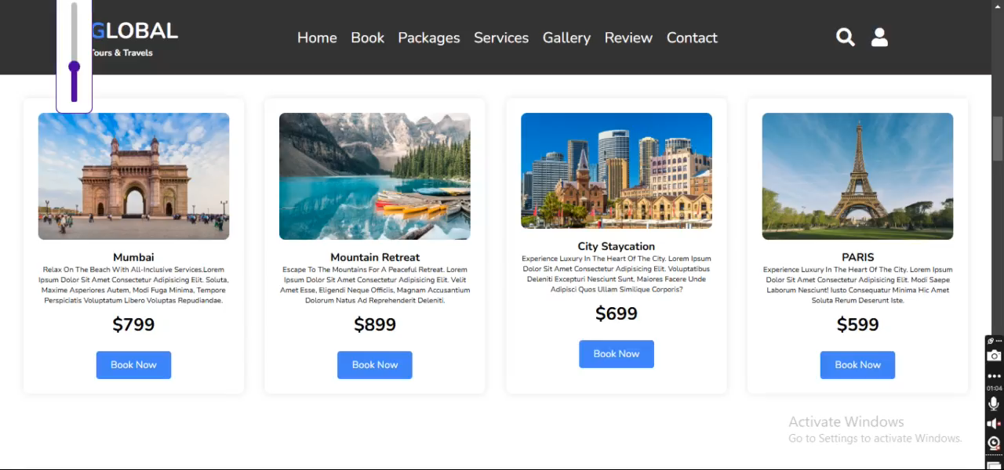
Code Screenshot: Booking Price Update

Slide 11

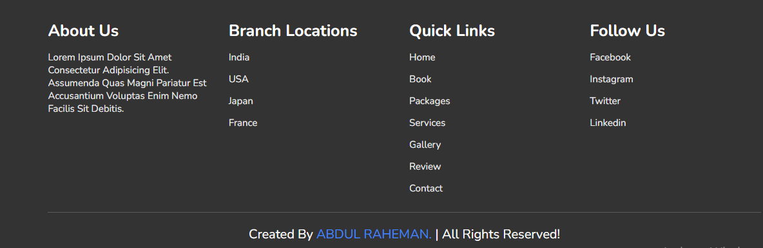
Navbar :
Footer:

Slide 12
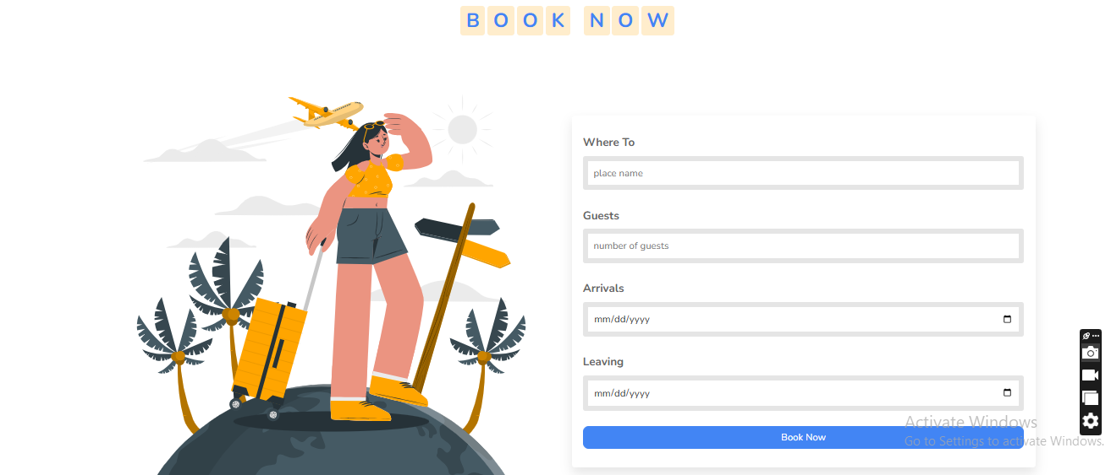
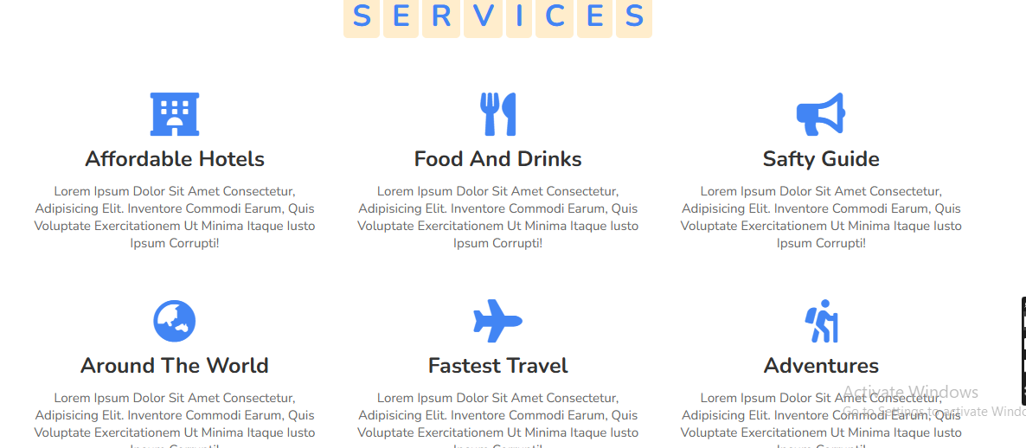
Book now :
Services :

Slide 13
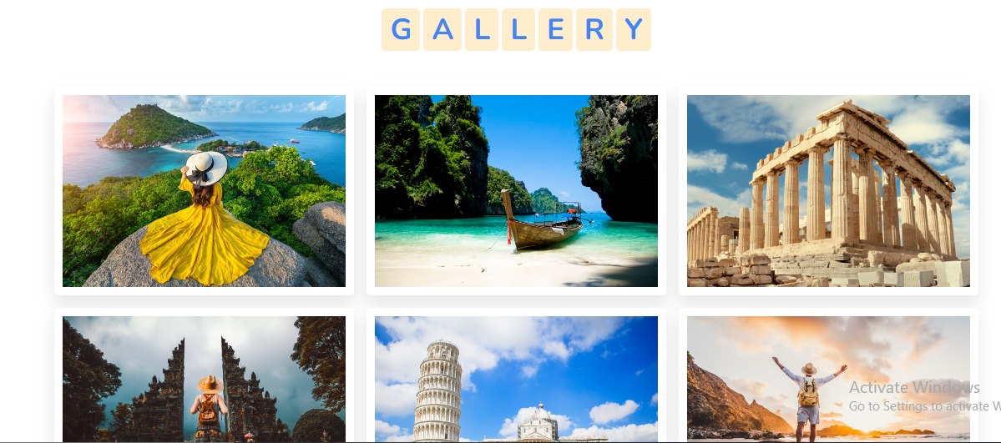
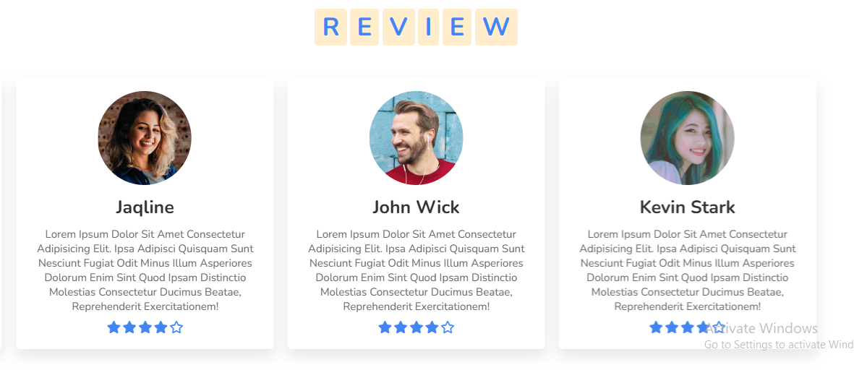
Gallery:
Review:

Slide 14
Thank you.
Presented by- Abdul Raheman.

